Slide 1
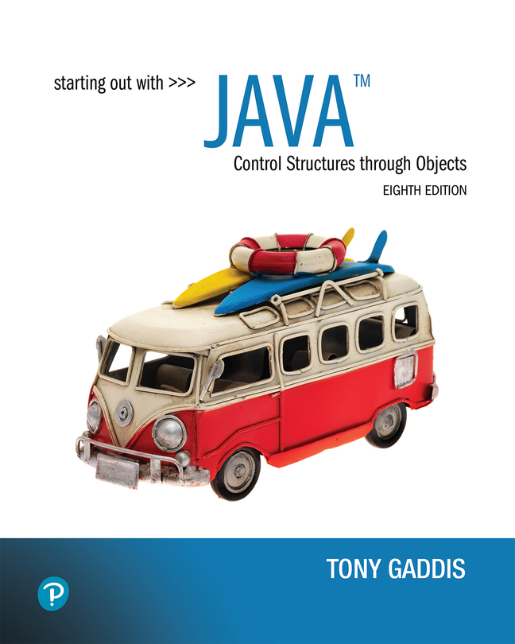

Starting Out with Java Control Structures Through Objects
Eighth Edition
Chapter 3
Decision Structures
Copyright © 2022 Pearson Education, Inc. All Rights Reserved
Notes:
If this PowerPoint presentation contains mathematical equations, you may need to check that your computer has the following installed:
1) MathType Plugin
2) Math Player (free versions available)
3) NVDA Reader (free versions available)

Slide 2
Chapter Topics (1 of 2)
Chapter 3 discusses the following main topics:
The if Statement
The if-else Statement
Nested if statements
The if-else-if Statement
Logical Operators
Comparing String Objects

Slide 3
Chapter Topics (2 of 2)
Chapter 3 discusses the following main topics:
More about Variable Declaration and Scope
The Conditional Operator
The switch Statement
Displaying Formatted Output with System.out.printf and String.format

Slide 4
The if Statement
The if statement decides whether a section of code executes or not.
The if statement uses a boolean to decide whether the next statement or block of statements executes.
if (boolean expression is true)
execute next statement.

Slide 5
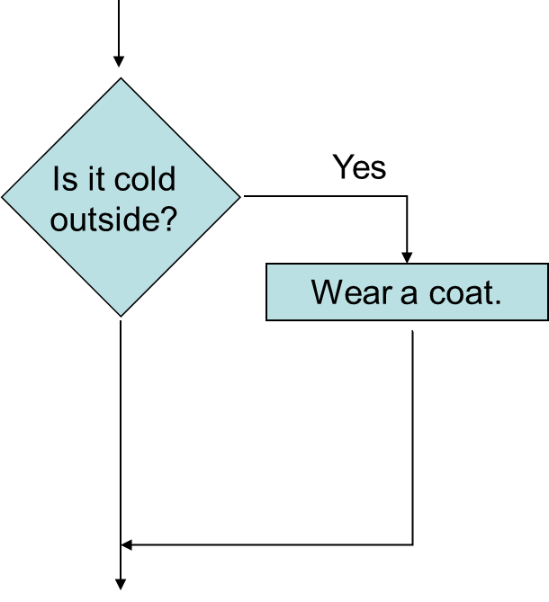
Flowcharts (1 of 2)
If statements can be modeled as a flow chart.
if (coldOutside)
wearCoat();

Slide 6
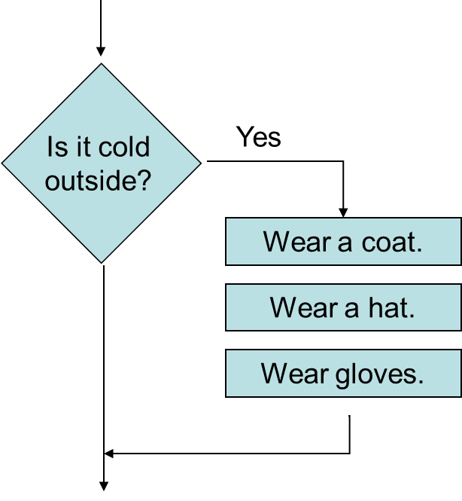
Flowcharts (2 of 2)
A block if statement may be modeled as:
if (coldOutside) {
wearCoat();
wearHat();
wearGloves();
}
Note the use of curly braces to block several statements together.
Notes:
The process flow is as follows. The condition reads, is it cold outside. If the condition is true, the next step includes the statements, wear a coat, wear a hat, wear a gloves. This step leads to the next step.

Slide 7
Relational Operators
In most cases, the boolean expression, used by the if statement, uses relational operators.
Relational Operator | Meaning
> | is greater than
< | is less than
>= | is greater than or equal to
<= | is less than or equal to
== | is equal to
!= | is not equal to

Slide 8
Boolean Expressions
A boolean expression is any variable or calculation that results in a true or false condition.
Expression | Meaning
x > y | Is x greater than y?
x < y | Is x less than y?
x >= y | Is x greater than or equal to y?
x <= y | Is x less than or equal to y.
x == y | Is x equal to y?
x != y | Is x not equal to y?

Slide 9
if Statements and Boolean Expressions
if (x > y)
System.out.println("X is greater than Y");
if (x == y)
System.out.println("X is equal to Y");
if (x != y)
{
System.out.println("X is not equal to Y");
x = y;
System.out.println("However, now it is.");
}
Example: AverageScore.java

Slide 10
Programming Style and if Statements (1 of 2)
An if statement can span more than one line; however, it is still one statement.
if (average > 95)
grade = ′A′;
is functionally equivalent to
if (average > 95) grade = ′A′;

Slide 11
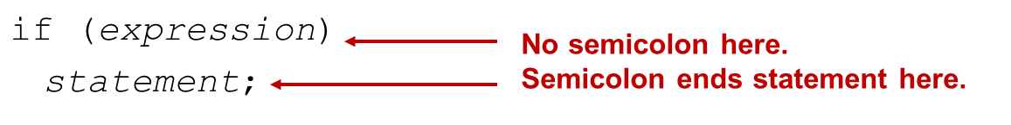
Programming Style and if Statements (2 of 2)
Rules of thumb:
The conditionally executed statement should be on the line after the if condition.
The conditionally executed statement should be indented one level from the if condition.
If an if statement does not have the block curly braces, it is ended by the first semicolon encountered after the if condition.
Notes:
Line 1. if left parenthesis expression right parenthesis. Line 1 is labeled, no semi colon here. Line 2. Indented once, statement semicolon. Line 2 is labeled, semicolon ends statement here.

Slide 12
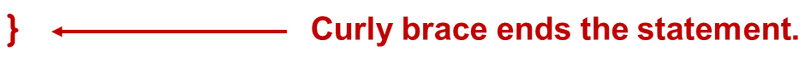
Block if Statements (1 of 2)
Conditionally executed statements can be grouped into a block by using curly braces {} to enclose them.
If curly braces are used to group conditionally executed statements, the if statement is ended by the closing curly brace.
if (expression)
{
statement1;
statement2;

Slide 13
Block if Statements (2 of 2)
Remember that when the curly braces are not used, then only the next statement after the if condition will be executed conditionally.
if (expression)
statement1;
statement2;
statement3;

Slide 14
Flags
A flag is a boolean variable that monitors some condition in a program.
When a condition is true, the flag is set to true.
The flag can be tested to see if the condition has changed.
if (average > 95)
highScore = true;
Later, this condition can be tested:
if (highScore)
System.out.println("That′s a high score!");

Slide 15
Comparing Characters
Characters can be tested with relational operators.
Characters are stored in memory using the Unicode character format.
Unicode is stored as a sixteen (16) bit number.
Characters are ordinal, meaning they have an order in the Unicode character set.
Since characters are ordinal, they can be compared to each other.
char c = 'A';
if(c < 'Z')
System.out.println("A is less than Z");

Slide 16
if-else Statements
The if-else statement adds the ability to conditionally execute code when the if condition is false.
if (expression)
statementOrBlockIfTrue;
else
statementOrBlockIfFalse;
See example: Division.java

Slide 17
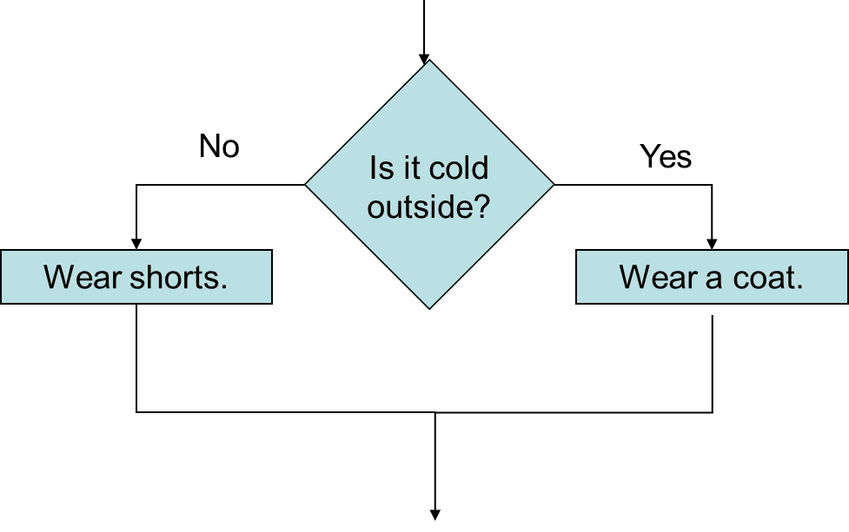
if-else Statement Flowcharts
Notes:
The process flow is as follows. The condition reads, is it cold outside. If the condition is true, the statement reads, wear a coat. If the condition is false, the statement reads, wear shorts. Both statements lead to the next step.

Slide 18
Nested if Statements (1 of 2)
If an if statement appears inside another if statement (single or block) it is called a nested if statement.
The nested if is executed only if the outer if statement results in a true condition.
See example: LoanQualifier.java

Slide 19
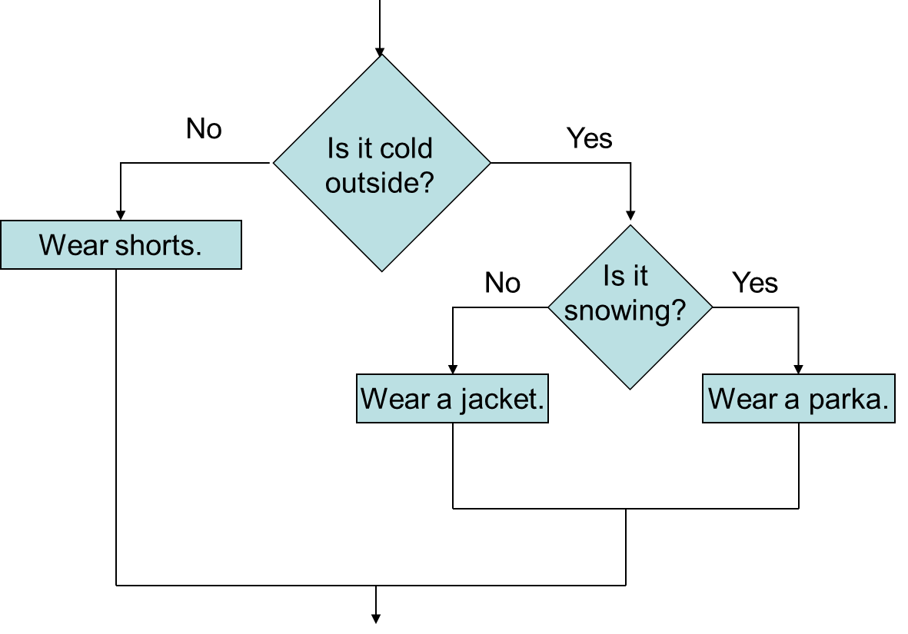
Nested if Statement Flowcharts
Notes:
The process flow is as follows. Condition 1 reads, is it cold outside. If condition 1 is true, the next step involves condition 2, which reads, is it snowing. If condition 2 is true, the statement reads, wear a parka. If condition 2 is false, the statement reads, wear a jacket. If condition 1 is false, the statement reads, wear shorts. The three statements lead to the next step.

Slide 20
Nested if Statements (2 of 2)
if (coldOutside)
{
if (snowing)
{
wearParka();
}
else
{
wearJacket();
}
}
else
{
wearShorts();
}

Slide 21
if-else Matching
Curly brace use is not required if there is only one statement to be conditionally executed.
However, sometimes curly braces can help make the program more readable.
Additionally, proper indentation makes it much easier to match up else statements with their corresponding if statement.

Slide 22
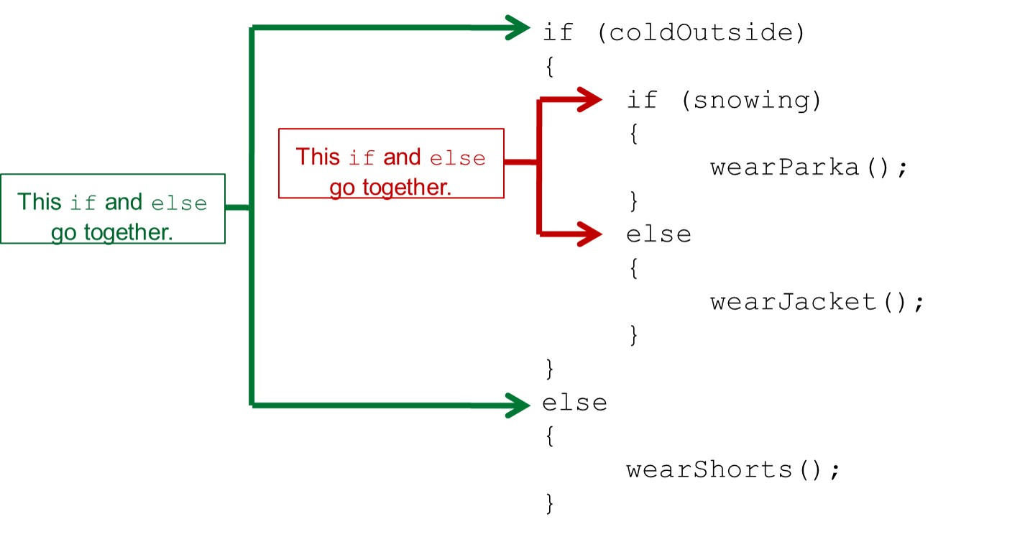
Alignment and Nested if Statements
Notes:
The lines are as follows. Line 1. if left parenthesis cold outside right parenthesis. Line 2. Left brace. Line 3. Indented once, if left parenthesis snowing right parenthesis. Line 4. Indented once, left brace. Line 5. Indented twice, wear Parka left parenthesis right parenthesis semicolon. Line 6. Indented twice, right brace. Line 7. Indented twice, else. Line 8. Indented twice, left brace. Line 9. Indented thrice, wear Jacket left parenthesis right parenthesis semicolon. Line 10. Indented twice, right brace. Line 11. Indented once, right brace. Line 12. Right brace. Line 13. Else. Line 14. Left brace. Line 15. Indented once, wear shorts left parentheis right parentheiss semicolon. Line 16. Right brace. Lines 3 and 7 are together labeled, this if and else go together. Lines 1 and 13 are together labeled, this if and else go together.

Slide 23


if-else-if Statements (1 of 3)
if (expression_1)
{
statement;
statement;
etc.
}
If expression_1 is true these statements are executed, and the rest of the structure is ignored.
else if (expression_2)
{
statement;
statement;
etc.
}
Otherwise, if expression_2 is true these statements are executed, and the rest of the structure is ignored.

Slide 24

if-else-if Statements (2 of 3)
Insert as many else if clauses as necessar
else
{
statement;
statement;
etc.
}
These statements are executed if none of the expressions above are true.

Slide 25
if-else-if Statements (3 of 3)
Nested if statements can become very complex.
The if-else-if statement makes certain types of nested decision logic simpler to write.
Care must be used since else statements match up with the immediately preceding unmatched if statement.
See example: TestResults.java

Slide 26
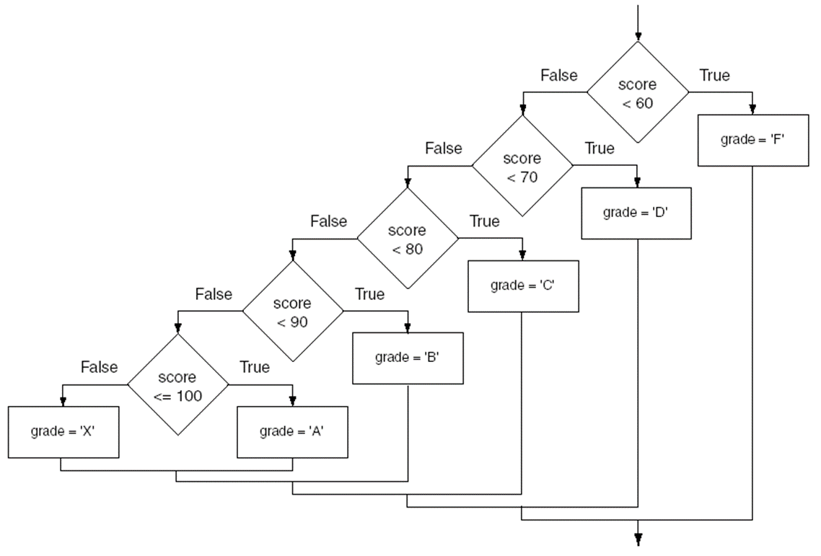
if-else-if Flowchart
Notes:
The process flow is as follows. Condition 1 reads, score less than 60. If condition 1 is true, the statement reads, grade = single quote F single quote. If condition 1 is false, the next step is condition 2, which reads, score less than 70. If condition 2 is true, the statement reads, grade = single quote D single quote. If condition 2 is false, the next step is condition 3, which reads, score less than 80. If condition 3 is true, the statement reads, grade = single quote C single quote. If condition 3 is false, the next step is condition 4, which reads, score less than 90. If condition 4 is true, the statement reads, grade = single quote B single quote. If condition 4 is false, the next step is condition 5, which reads, score less than 100. If condition 5 is true, the statement reads, grade = single quote A single quote. If condition 5 is false, the statement reads, grade = single quote X single quote. All statements lead to the next step.

Slide 27
Logical Operators (1 of 2)
Java provides two binary logical operators
that are used to combine boolean expressions.
Java also provides one unary (!) logical operator to reverse the truth of a boolean expression.

Slide 28
Logical Operators (2 of 2)
Operator | Meaning | Effect
&& | AND | Connects two Boolean expressions into one. Both expressions must be true for the overall expression to be true.
|| | OR | Connects two Boolean expressions into one. One or both expressions must be true for the overall expression to be true. It is only necessary for one to be true, and it does not matter which one.
! | NOT | The ! operator reverses the truth of a Boolean expression. If it is applied to an expression that is true, the operator returns false. If it is applied to an expression that is false, the operator returns true.

Slide 29
The && Operator
The logical AND operator (&&) takes two operands that must both be boolean expressions.
The resulting combined expression is true if (and only if) both operands are true.
See example: LogicalAnd.java
Expression 1 | Expression 2 | Expression1 && Expression2
true | false | false
false | true | false
false | false | false
true | true | true

Slide 30
The || Operator
The logical OR operator (||) takes two operands that must both be boolean expressions.
The resulting combined expression is false if (and only if) both operands are false.
Example: LogicalOr.java
Expression 1 | Expression 2 | Expression1 double vertical bars Expression2
true | false | true
false | true | true
false | false | false
true | true | true

Slide 31
The ! Operator
The ! operator performs a logical NOT operation.
If an expression is true, !expression will be false.
if (!(temperature > 100))
System.out.println("Below the maximum temperature.");
If temperature > 100 evaluates to false, then the output statement will be run.
Expression 1 | !Expression1
true | false
false | true

Slide 32
Short Circuiting
Logical AND and logical OR operations perform short-circuit evaluation of expressions.
Logical AND will evaluate to false as soon as it sees that one of its operands is a false expression.
Logical OR will evaluate to true as soon as it sees that one of its operands is a true expression.

Slide 33
Order of Precedence (1 of 2)
The ! operator has a higher order of precedence than the && and || operators.
The && and || operators have a lower precedence than relational operators like < and >.
Parenthesis can be used to force the precedence to be changed.

Slide 34
Order of Precedence (2 of 2)
Order of Precedence | Operators | Description
1 | (unary negation) ! | Unary negation, logical NOT
2 | * / % | Multiplication, Division, Modulus
3 | + − | Addition, Subtraction
4 | < > <= >= | Less-than, Greater-than, Less-than or equal to, Greater-than or equal to
5 | == != | Is equal to, Is not equal to
6 | && | Logical AND
7 | || | Logical NOT
8 | = += −= *= /= %= | Assignment and combined assignment operators.

Slide 35
Comparing String Objects
In most cases, you cannot use the relational operators to compare two String objects.
Reference variables contain the address of the object they represent.
Unless the references point to the same object, the relational operators will not return true.
See example: StringCompare.java
See example: StringCompareTo.java

Slide 36
Ignoring Case in String Comparisons
In the String class the equals and compareTo methods are case sensitive.
In order to compare two String objects that might have different case, use:
equalsIgnoreCase, or
compareToIgnoreCase
See example: SecretWord.java

Slide 37
Variable Scope
In Java, a local variable does not have to be declared at the beginning of the method.
The scope of a local variable begins at the point it is declared and terminates at the end of the method.
When a program enters a section of code where a variable has scope, that variable has come into scope, which means the variable is visible to the program.
See example: VariableScope.java

Slide 38
The Conditional Operator (1 of 4)
The conditional operator is a ternary (three operand) operator.
You can use the conditional operator to write a simple statement that works like an if-else statement.

Slide 39
The Conditional Operator (2 of 4)
The format of the operators is:
BooleanExpression ? Value1 : Value2
This forms a conditional expression.
If BooleanExpression is true, the value of the conditional expression is Value1.
If BooleanExpression is false, the value of the conditional expression is Value2.

Slide 40
The Conditional Operator (3 of 4)
Example:
z = x > y ? 10 : 5;
This line is functionally equivalent to:
if(x > y)
z = 10;
else
z = 5;

Slide 41
The Conditional Operator (4 of 4)
Many times the conditional operator is used to supply a value.
number = x > y ? 10 : 5;
This is functionally equivalent to:
if(x > y)
number = 10;
else
number = 5;
See example: ConsultantCharges.java

Slide 42
The switch Statement (1 of 4)
The if-else statement allows you to make true / false branches.
The switch statement allows you to use an ordinal value to determine how a program will branch.
The switch statement can evaluate a variable or an expression that gives a char, byte, short, int, or string value, and make decisions based on the value.

Slide 43
The switch Statement (2 of 4)
The switch statement takes the form:
switch (TestExpression)
{
case CaseExpression:
// place one or more statements here
break;
case CaseExpression:
// place one or more statements here
break;
// case statements may be repeated
//as many times as necessary
default:
// place one or more statements here
}

Slide 44
The switch Statement (3 of 4)
switch (TestExpression)
{
…
}
The switch statement will evaluate the TestExpression, which can be a char, byte, short, int, or string.
If there is an associated case statement that matches that value, program execution will be transferred to that case statement.

Slide 45
The switch Statement (4 of 4)
Each case statement will have a corresponding CaseExpression that must be unique.
case CaseExpression:
// place one or more statements here
break;
If the TestExpression matches the CaseExpression, the Java statements between the colon and the break statement will be executed.

Slide 46
The case Statement
The break statement ends the case statement.
The break statement is optional.
If a case does not contain a break, then program execution continues into the next case.
See example: NoBreaks.java
See example: PetFood.java
The default section is optional and will be executed if no CaseExpression matches the TestExpression.
See example: SwitchDemo.java

Slide 47
Multi Value case Statements
With Java 12 or later, you can specify multiple values separated by commas in a case statement.
switch (number)
{
case 1, 3, 5, 7, 9:
System.out.println("Odd");
break;
case 2, 4, 6, 8, 10:
System.out.println("Even");
break;
default:
System.out.println("Number out of range");
}
When any of the case values match the switch statement’s TestExpression, the statements in the case section are executed.

Slide 48
Arrow case Syntax (1 of 4)
With Java 12 or later, you can use arrow case syntax in a switch statement.
case value -> statement;
The case value is followed by the arrow operator (->) which is followed by a single statement.
When the case value matches the switch statement’s TestExpression, the statement to the right of the arrow operator is executed and the program breaks out of the switch statement.

Slide 49
Arrow case Syntax (2 of 4)
Example:
switch (month)
{
case 1 -> System.out.println("January");
case 2 -> System.out.println("February");
case 3 -> System.out.println("March");
default -> System.out.println("Error: Invalid month");
}

Slide 50
Arrow case Syntax (3 of 4)
Arrow case syntax allows you to specify multiple values in a case statement.
switch (month)
{
case 1, 2, 3, 4, 5 -> System.out.println("Spring Semester");
case 6, 7 -> System.out.println("Summer Semester");
case 8, 9, 10, 11, 12 -> System.out.println("Fall Semester");
default -> System.out.println("Error: Invalid month");
}

Slide 51
Arrow case Syntax (4 of 4)
If you need to write more than one statement in a case section, you must enclose those statements in curly braces
switch (month)
{
case 1 ->
{
monthName = "January";
System.out.println(monthName);
}
case 2 ->
{
monthName = "February";
System.out.println(monthName);
}
case 3 ->
{
monthName = "March";
System.out.println(monthName);
}
default ->
{
monthName = "Invalid";
System.out.println("Error: Invalid month");
}
}

Slide 52
switch Expressions (1 of 6)
In Java 12 and later, the switch statement can be written as an expression that gives a value.
Example:
String numstring;
numstring = switch(number) { case 0 -> "Zero"; case 1 -> "One"; case 2 -> "Two"; default -> "Unknown"; };

Slide 53
switch Expressions (2 of 6)
If the value of number is 0, the string "Zero" will be assigned to numstring.
If the value of number is 1, the string "One" will be assigned to numstring.
If the value of number is 2, the string "Two". The string "Two" will be assigned to numstring.
If the value of number is not 0, 1, or 2, the string "Unknown" will be assigned to numstring.

Slide 54

switch Expressions (3 of 6)
Don’t forget the semicolon at the end of the statement!
String numstring;
numstring = switch(number) { case 0 -> "Zero"; case 1 -> "One"; case 2 -> "Two"; default -> "Unknown"; };

Slide 55
switch Expressions (4 of 6)
A switch expression must be exhaustive.
This means that it must have case statements that cover every possible value of the TestExpression.
In most situations, this simply means that a switch expression must have a default section.

Slide 56
switch Expressions (5 of 6)
If a case section in a switch expression has more than one statement, you must use the yield keyword to return a value from that case section.

Slide 57
switch Expressions (6 of 6)
message = switch(statusCode)
{
case 200 ->
{
statusType = "Successful";
yield "OK";
}
case 404 ->
{
statusType = "Client Error";
yield "Not Found";
}
default ->
{
statusType = "Unsupported";
yield "Unknown Status";
}
};

Slide 58
The System.out.printf Method (1 of 15)
You can use the System.out.printf method to perform formatted console output.
The general format of the method is:
System.out.printf(FormatString, ArgList);

Slide 59
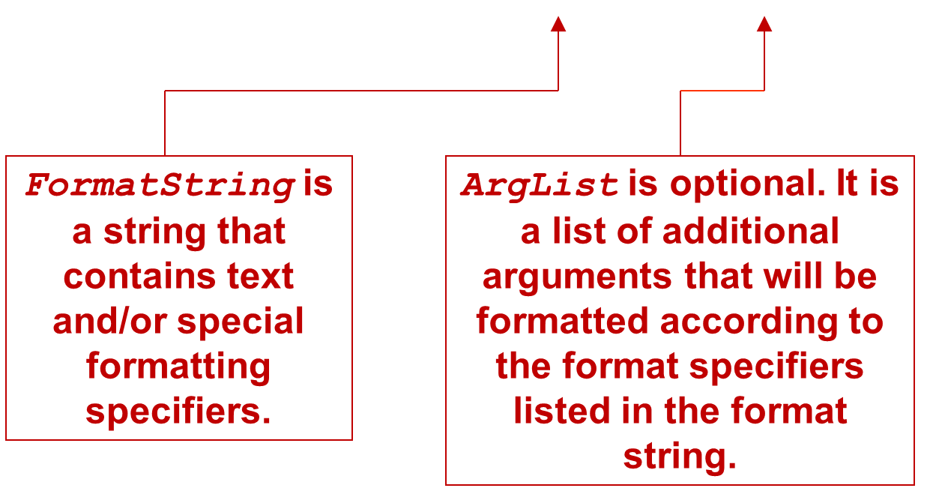
The System.out.printf Method (2 of 15)
System.out.printf(FormatString, ArgList);
Notes:
Format string is labeled, format string is a string that contains text and slash or special formatting specifiers. A r g list is labeled, a r g list is optional. It is a list of additional arguments that will be formatted according to the format specifiers listed in the format string.

Slide 60
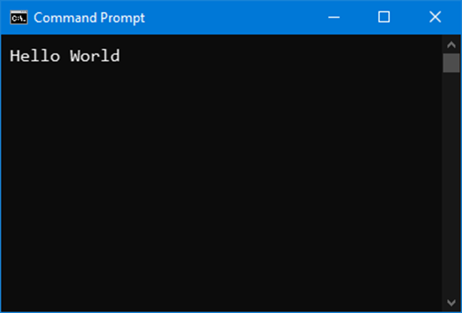
The System.out.printf Method (3 of 15)
A simple example:
System.out.printf("Hello World\n");

Slide 61
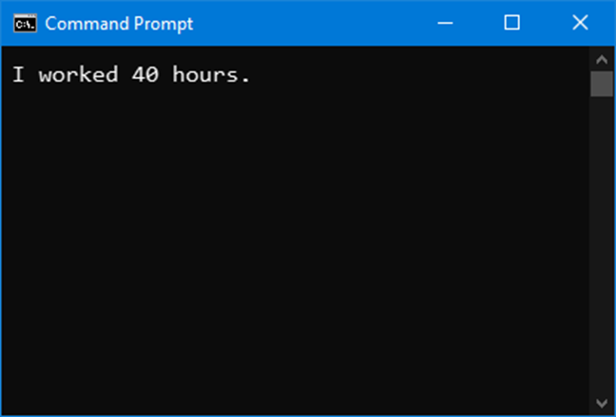
The System.out.printf Method (4 of 15)
Another example:
int hours = 40;
System.out.printf("I worked %d hours.\n", hours);

Slide 62
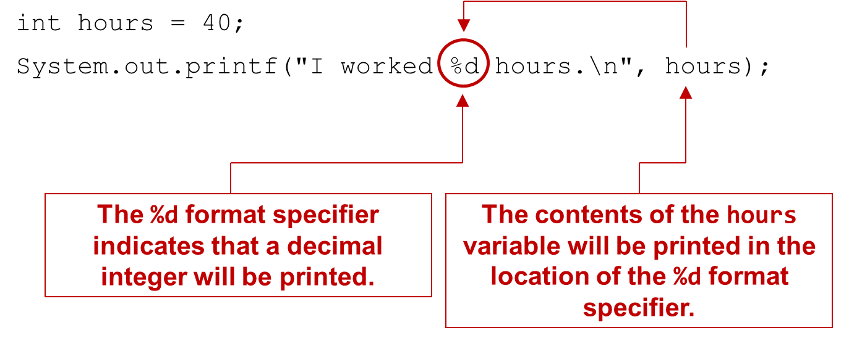
The System.out.printf Method (5 of 15)
Notes:
The program code is as follows. Line 1. I n t hours = 40 semicolon. Line 2. System dot out dot print f left parenthesis double quotes I worked %d hours dot left slash n double quotes comma hours right parenthesis semicolon. In line 2, an arrow from the hours extends to %d. %d is highlighted and labeled, the %d format specifier indicates that a decimal integer will be printed. Hours is labeled, the contents of the hours variable will be printed in the location of the %d format specifier.

Slide 63
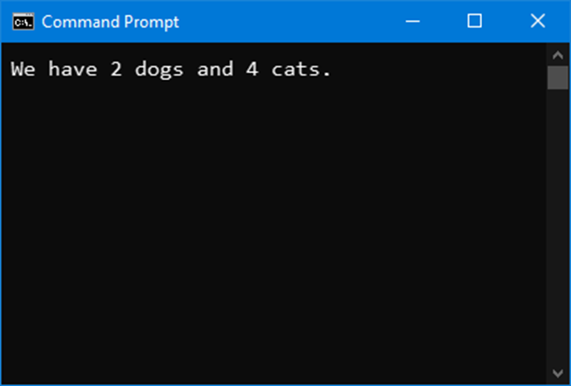
The System.out.printf Method (6 of 15)
Another example:
int dogs = 2, cats = 4;
System.out.printf("We have %d dogs and %d cats.\n",
dogs, cats);

Slide 64
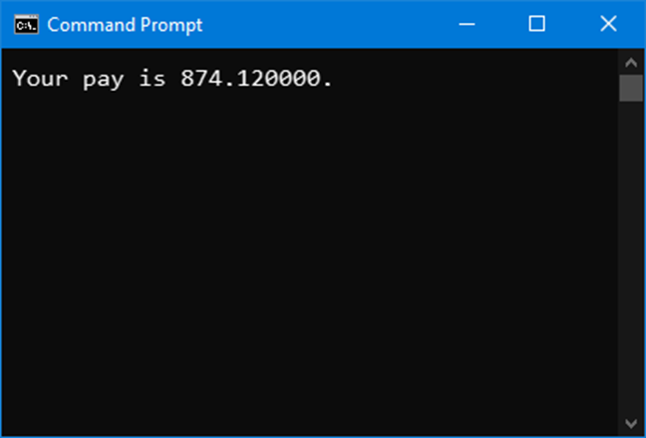
The System.out.printf Method (7 of 15)
Another example:
double grossPay = 874.12;
System.out.printf("Your pay is %f.\n", grossPay);

Slide 65
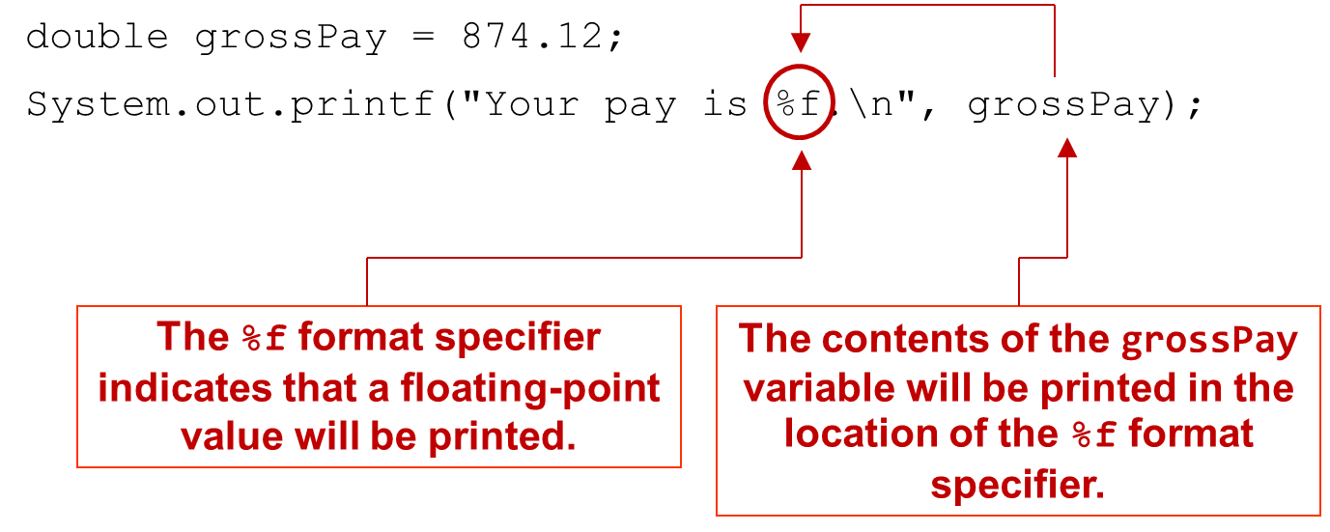
The System.out.printf Method (8 of 15)
Another example:
Notes:
The program code is as follows. Line 1. Double gross pay = 874.12 semicolon. Line 2. System dot out dot print f left parenthesis double quotes Your pay is %f dot left slash n double quotes comma gross pay right parenthesis semicolon. In line 2, an arrow from gross pay extends to %f. %f is highlighted and labeled, the %f format specifier indicates that a floating point value will be printed. Gros pay is labeled, the contents of the gross pay variable will be printed in the location of the %f format specifier.

Slide 66
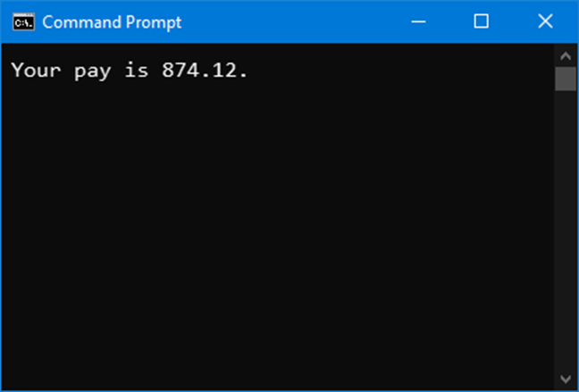
The System.out.printf Method (9 of 15)
Another example:
double grossPay = 874.12;
System.out.printf("Your pay is %.2f.\n", grossPay);

Slide 67
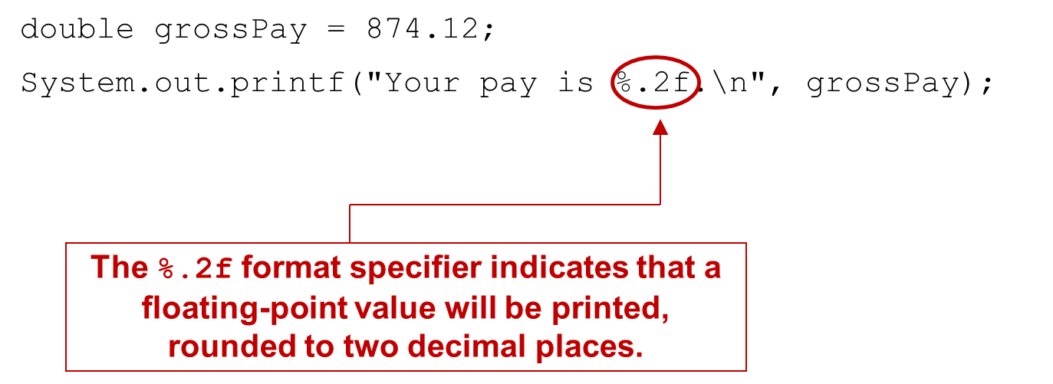
The System.out.printf Method (10 of 15)
Another example:
Notes:
The program code is as follows. Line 1. Double gross pay = 874.12 semicolon. Line 2. System dot out dot print f left parenthesis double quotes Your pay is % dot 2 f dot left slash n double quotes comma gross pay right parenthesis semicolon. % dot 2 f is highlighted and labeled, the % dot 2 f format specifier indicates that a floating point value will be printed, rounded to two decimal places.

Slide 68
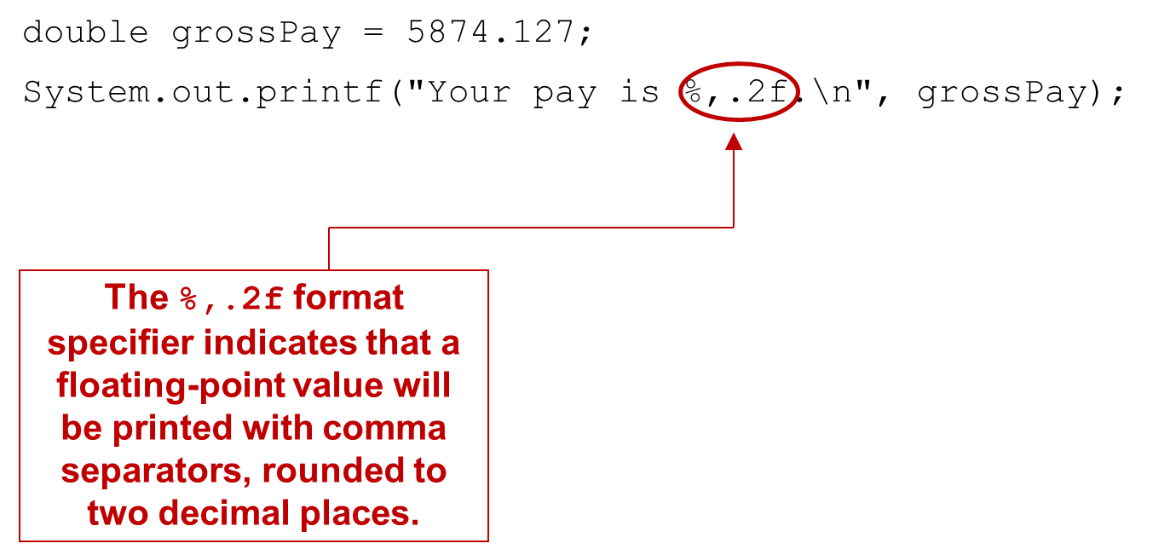
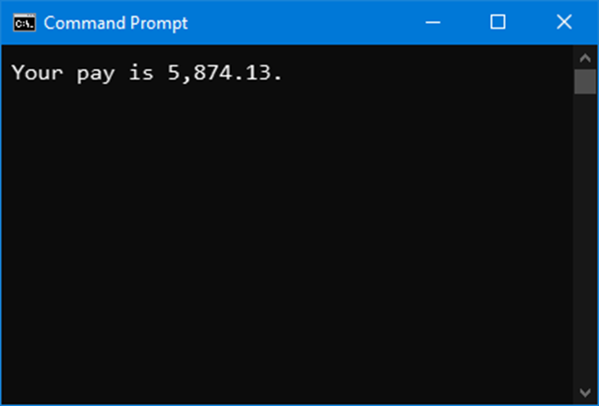
The System.out.printf Method (11 of 15)
Another example:
Notes:
The program code is as follows. Line 1. Double gross pay = 5874.127 semicolon. Line 2. System dot out dot print f left parenthesis double quotes Your pay is % comma dot 2 f dot left slash n double quotes comma gross pay right parenthesis semicolon. % comma dot 2 f is highlighted and labeled, the % comma dot 2 f format specifier indicates that a floating point value will be printed with comma separators, rounded to two decimal places.

Slide 69
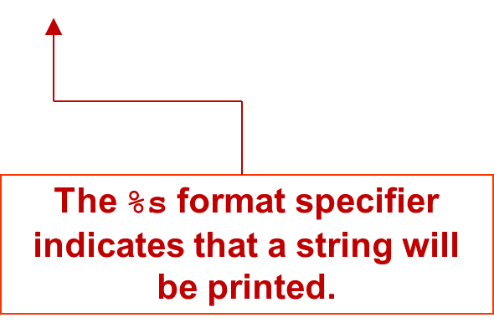
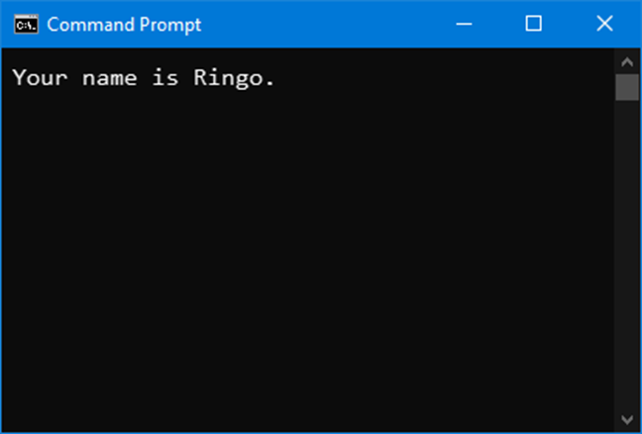
The System.out.printf Method (12 of 15)
Another example:
String name = "Ringo";
System.out.printf("Your name is %s.\n", name);

Slide 70
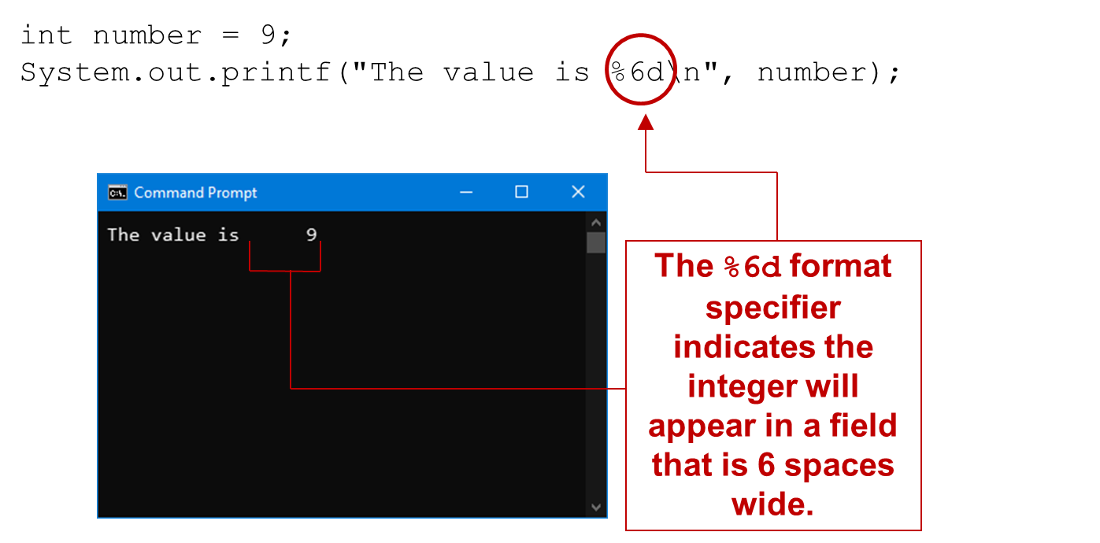
The System.out.printf Method (13 of 15)
Specifying a field width:
Notes:
The program code has 2 lines as follows. Line 1. I n t number = 9 semicolon. Line 2. System dot out dot print f left parenthesis double quotes the value is % 6 d left slash n double quotes comma number right parenthesis semicolon. The command prompt window displays the text, the value is 9. % 6 d in line 2 is highlighted and labeled along with the text in the command prompt window as follows. The % d format specifier indicates the integer will appear in a field that is 6 spaces.

Slide 71
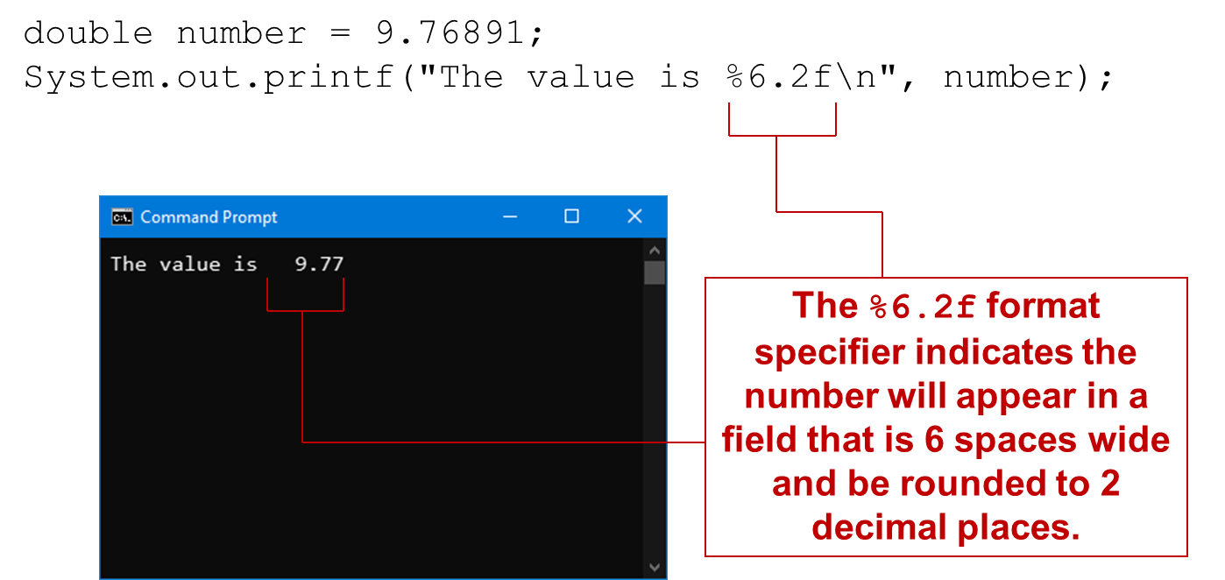
The System.out.printf Method (14 of 15)
Another example:
Notes:
The program code has 2 lines as follows. Line 1. Double number = 9.76891 semicolon. Line 2. System dot out dot print f left parenthesis double quotes the value is % 6 dot 2 f left slash n double quotes comma number right parenthesis semicolon. The command prompt window displays the text, the value is 9.77. % 6 dot 2 f in line 2 is labeled along with the text in the command prompt window as follows. The % 6 dot 2 f format specifier indicates the number will appear in a field that is 6 spaces wide and be rounded to 2 decimal places.

Slide 72
The System.out.printf Method (15 of 15)
See examples:
Columns.java
CurrencyFormat.java

Slide 73
The String.format Method (1 of 3)
The String.format method works exactly like the System.out.printf method, except that it does not display the formatted string on the screen.
Instead, it returns a reference to the formatted string.
You can assign the reference to a variable, and then use it later.

Slide 74
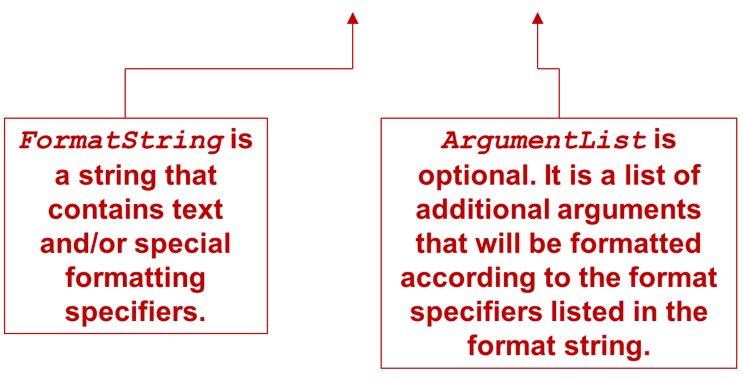
The String.format Method (2 of 3)
The general format of the method is:
String.format(FormatString,ArgumentList);
Notes:
Format string is labeled, format string is a string that contains text and slash or special formatting specifiers. Argument list is labeled, Argument list is optional. It is a list of additional arguments that will be formatted according to the format specifiers listed in the format string.

Slide 75
The String.format Method (3 of 3)
See examples:
CurrencyFormat2.java
CurrencyFormat3.java

Slide 76

Copyright
This work is protected by United States copyright laws and is provided solely for the use of instructors in teaching their courses and assessing student learning. Dissemination or sale of any part of this work (including on the World Wide Web) will destroy the integrity of the work and is not permitted. The work and materials from it should never be made available to students except by instructors using the accompanying text in their classes. All recipients of this work are expected to abide by these restrictions and to honor the intended pedagogical purposes and the needs of other instructors who rely on these materials.

